Slide 1
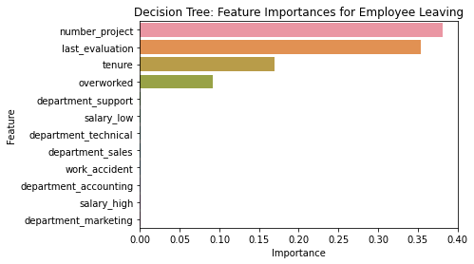
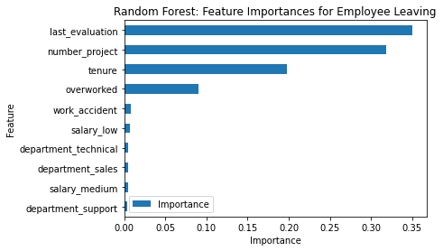
Salifort Motors
Employee Retention Project
Salifort Motors aims to enhance employee retention while addressing the following question:
What’s likely to make the employee leave the company?
Given that the target variable is categorical, the team has the option to construct either a logistic regression model or a machine learning model based on decision trees.
The performance of the random forest model surpasses that of the decision tree model by a slight margin.
Barplot above shows the most relevant variables: ‘last_evaluation’, ‘number_project’, ‘tenure’ and ‘overworked’.
By utilizing this model, HR can predict the likelihood of an employee leaving and determine the key influential factors. These valuable insights can assist HR in making informed decisions to enhance employee retention.
In the random forest model above, `last_evaluation`, `tenure`, `number_project`, `overworked`, `salary_low`, and `work_accident` have the highest importance. These variables are most helpful in predicting the outcome variable, `left`.
Cap the number of projects that employees can work on.
Consider promoting employees who have been with the company for at least four years, or conduct further investigation about why four-year tenured employees are so dissatisfied.
Either reward employees for working longer hours, or don't require them to do so.
If employees aren't familiar with the company's overtime pay policies, inform them about this. If the expectations around workload and time off aren't explicit, make them clear.
Hold company-wide and within-team discussions to understand and address the company work culture, across the board and in specific contexts.
High evaluation scores should not be reserved for employees who work 200+ hours per month. Consider a proportionate scale for rewarding employees who contribute more/put in more effort.

